Slide 1
VPBankReport
Author: Dat Duong

Slide 2
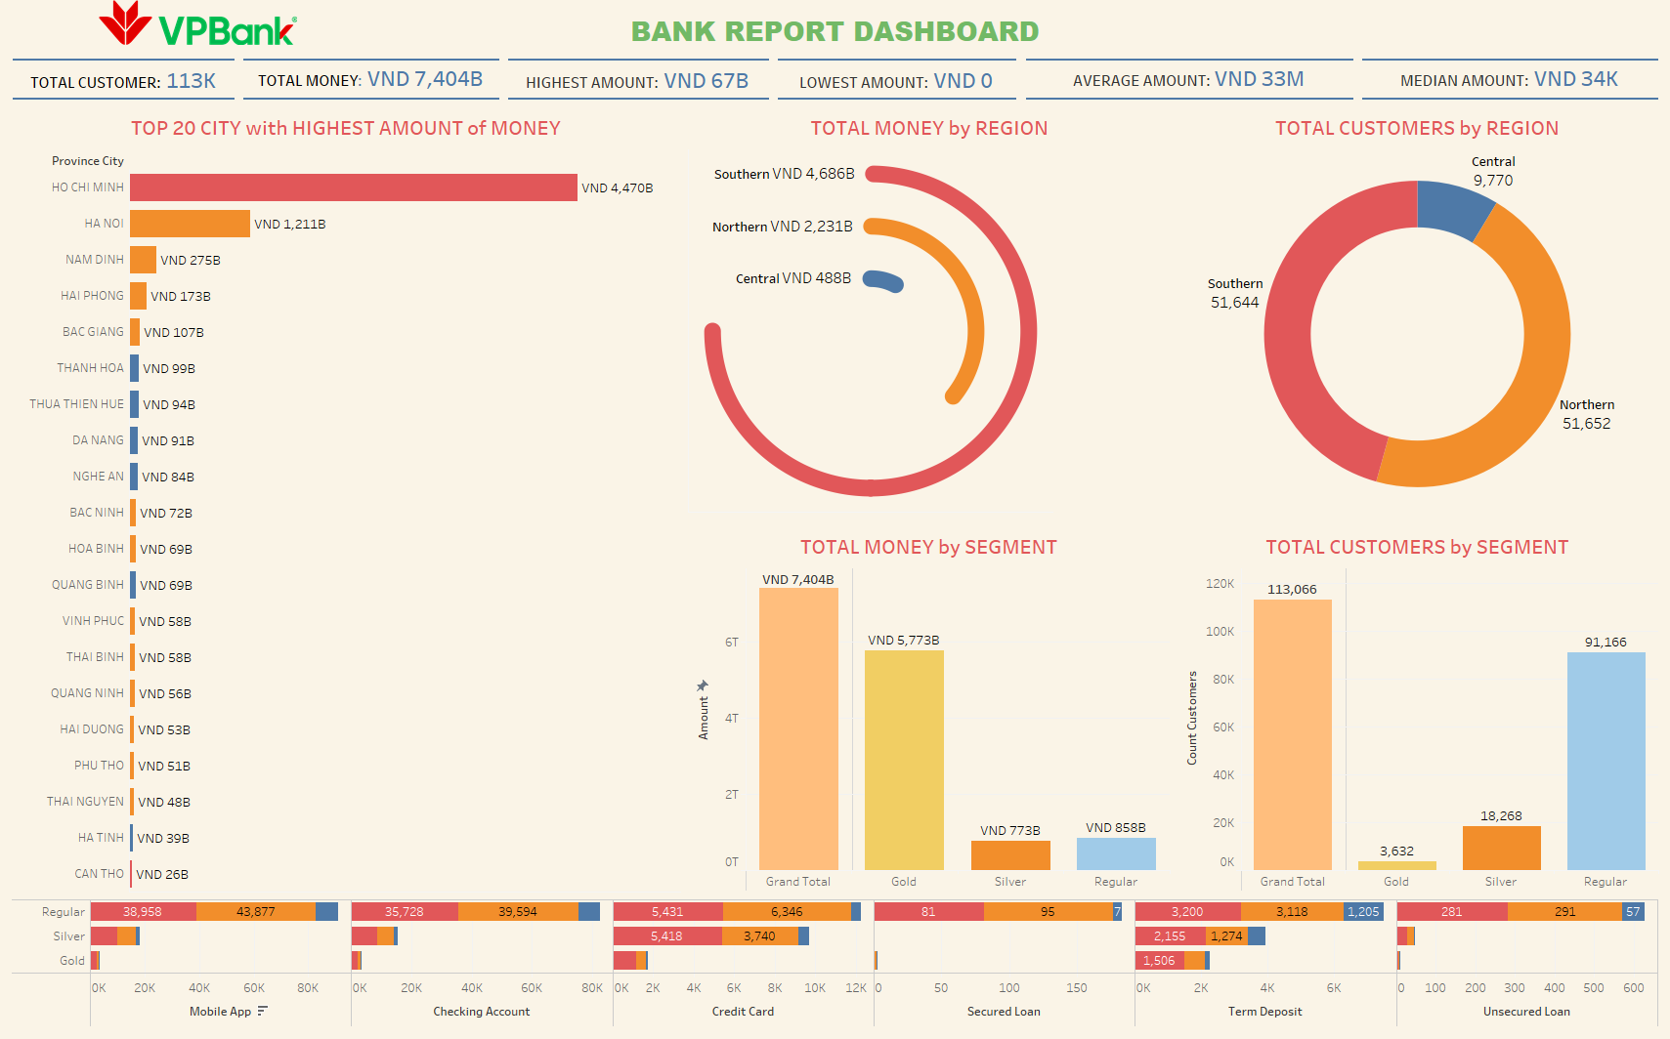
Overview
The total customers are 113K with the majority resides the North and South of Vietnam, with a total revenue of 7,404B and the highest amount of money recorded in a single transaction is 67B. This indicates that the bank has a wide range of customers geographically and financially.

Slide 3
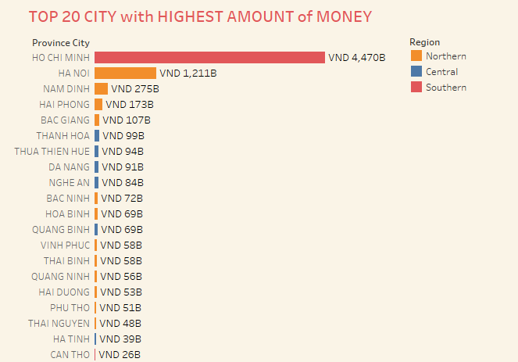
Customers Analysis
The bar chart illustrates the top 20 cities in Vietnam that generated the most money. It reveals that Ho Chi Minh City dominated not only the South but the entire nation with 4,470B, significantly surpassing Ha Noi at 1,211B. Cities in the North such as Nam Dinh and Hai Phong also contributed huge cash inflow at 275B and 173B respectively. Da Nang (91B) and Thanh Hoa (99B) are two of the Central region’s significant contributors.

Slide 4
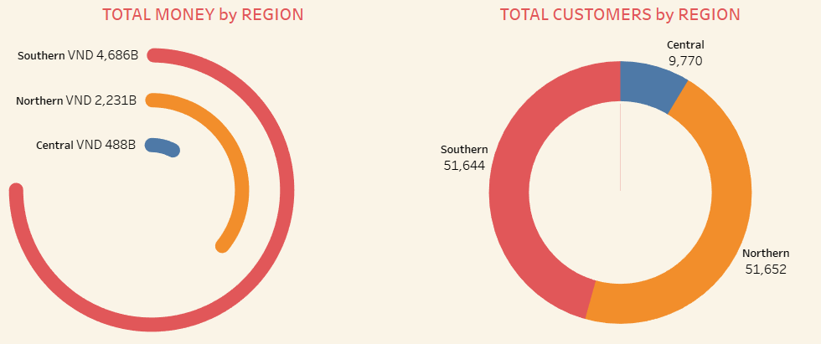
Customers Analysis
- Southern : with 4,686B and 51,644 customers, benefits from being the most developed area, including the largest financial center such as Ho Chi Minh City, which has higher income levels and extensive commercial activities.
- Northern: includes the capital city Ha Noi generates 2,231B from 51,652 clients, demonstrating a diverse range of economic activity, involving governmental and administrative tasks. This leads to a wide range of income levels that might result in lower expenditure than in the South.
- Central: due to its smaller economy and lower population density the central area, including cities such as Da Nang, which collectively contributes to lower spending powers and falls behind with just 488B from 9,770 clients.

Slide 5
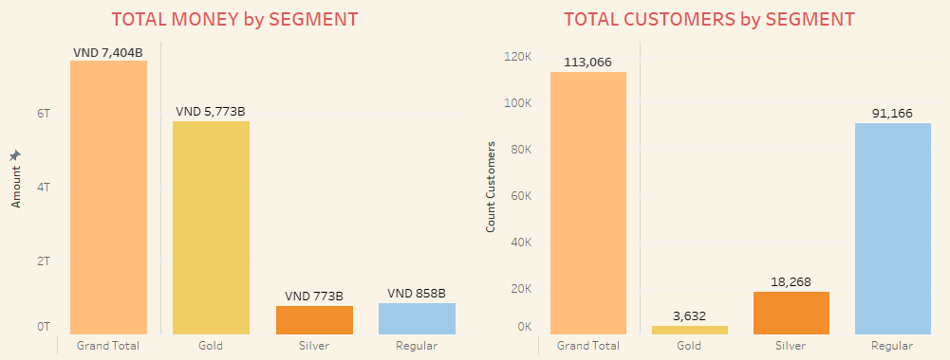
Customers Analysis
The graph illustrates a strong contrast between the total money spent and the number of clients in each segment. Even though there are only a few customers in the Gold segment, they generated the most value for the company with 5773B, demonstrating substantial expenditure per customer. The regular segment has the greatest number of clients (91,166) but its overall revenue of 858B is comparatively lower, showing that customers in this segment spend less money. With 18,268 clients, the Silver segment has moderate expenditure, generating 773B in revenue. This discrepancy demonstrates how Gold sector clients considerably impact the overall revenue.

Slide 6
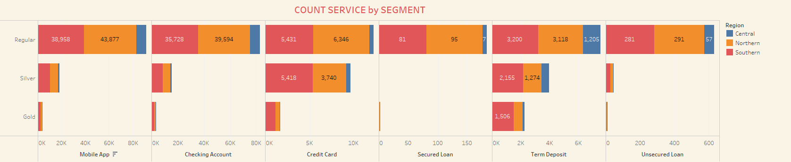
Customers Analysis
The visualization shows the number of customers using each service in Vietnam based on their segments:
- Regular: customers in this segment mostly use both mobile app services and checking accounts, while secured and unsecured loans receive less attention. Regular clients have lesser financial needs that do not require huge loans, are more risk-averse, and prefer to avoid debt.
- Silver: has a considerable number of clients using Mobile App, Checking Accounts, and Credit Card. However, there are no clients using secured loans. They might have alternative sources of funding.
- Gold: credit cards are popular among Gold customers due to the high credit limits, premium rewards, and exclusive benefits. Similarly, they have the financial stability to allocate funds to term deposits, ensuring their money works for them while maintaining liquidity for other investments.

Slide 7
Thanks!
Do you have any questions?
duongleminhdat20040512@gmail.com
437 255 2999

